Slide 1


Name: ARJUN TANEJA Branch: BCA Section: B Roll No: 229184

Slide 2

INDEX
INTRODUCTON
HEADER AREA
CONTENT AREA
FOOTER AREA

Slide 3

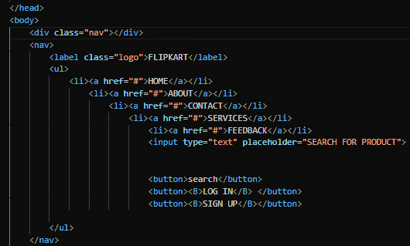
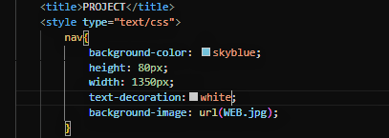
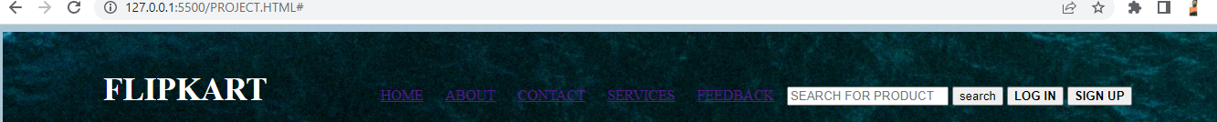
Some Pictures from my Website HEADER AREA

Slide 4


CONTENT AREA

Slide 5


Slide 6
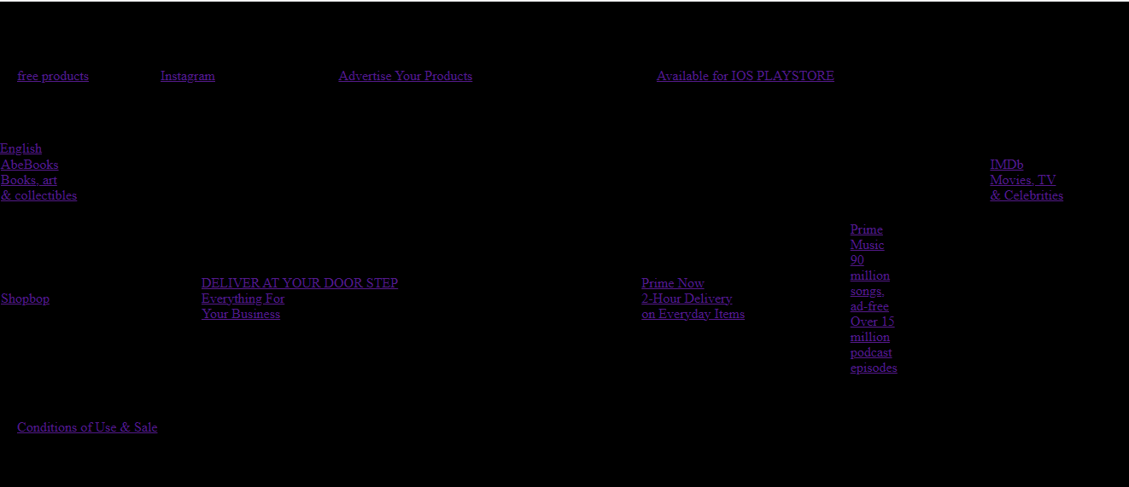
FOOTER AREA

Slide 7
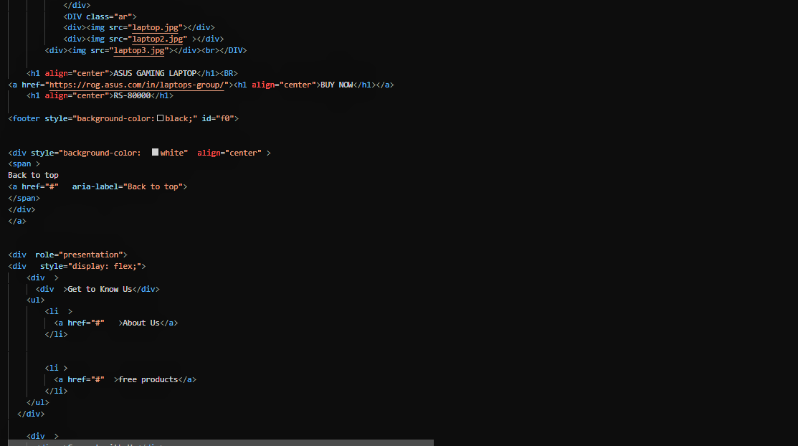
FOOTER CODE

Slide 8

BIBLIOGRAPHY
The Text Editor used for making this Website is Visual Studio Code
Images are taken with the help of Google Images

Slide 9


